Slide 1
Bioptic functions
From:
UCSC_version12b.ppt
UCSC advanced user manual

Slide 2
Report
From:
UCSC_version12b.ppt
UCSC advanced user manual

Slide 3
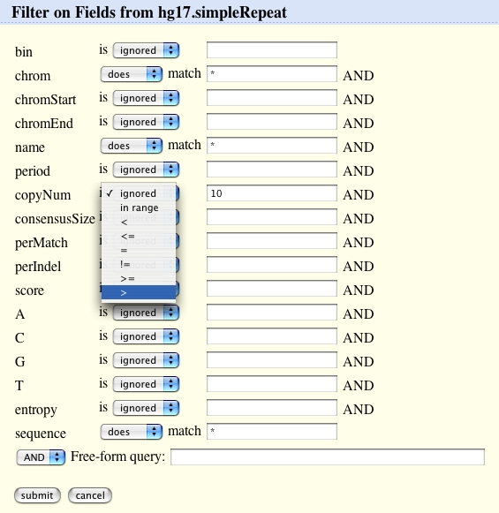
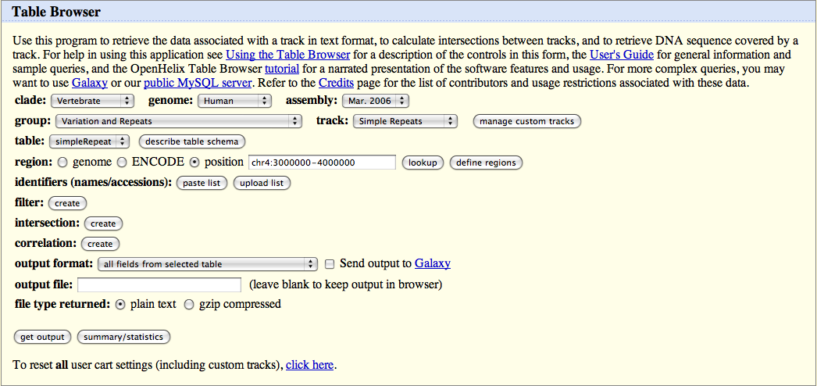

Table Browser: Filter to Refine Search
Create Filter
Submit Filter
In the Human genome,
search for simple repeats on a chromosome 4 location with copy number more than 10 and download the sequence.
Notes:
One of the powerful features of the Table Browser is the ability to filter the data table on various criteria. This is a ‘form based sql query’, allowing you to filter for different parameters of the fields in the table.
By clicking the filter “create” button, you can access a form to create a filter. In this form we can filter on the number of cytosines or guanines a simple repeat contains or match a specific sequence.
For example, our task is to download simple repeats, but only those with copy number over 10. So here we filter for simple repeats with a copy number greater than 10 by changing the pull down menu for “copynum” to the greater than sign and then typing 10 into the box. If you know the sql [pronounced “see quill”] query language, you can use the last box called “free form query” to type in your own custom filter. However, knowing sql is not essential to using this filter form. If there were more tables that the track was based on or related to, those too will show up on this page and you can filter on those.

Slide 4
View
From:
UCSC_version12b.ppt
UCSC advanced user manual

Slide 5
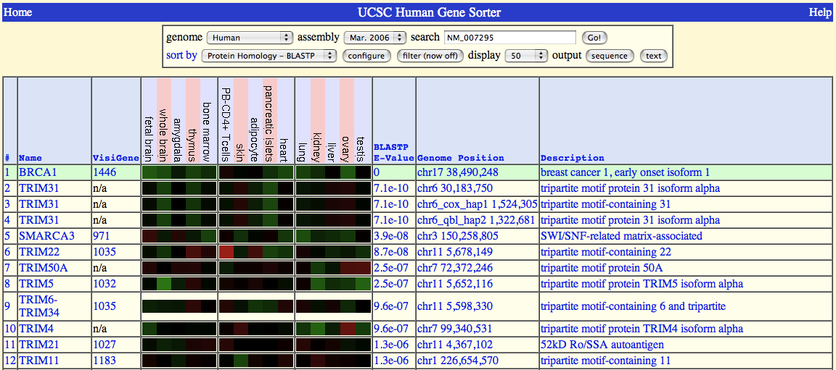
Gene Sorter
Sort genes by
similarity criteria
Notes:
Here, I am showing you the results of a search to give you an idea of what the Gene Sorter does.
The Gene Sorter takes a gene of interest and lists other genes in the genome sorted by a similarity type to the reference gene you chose. Each gene listed also has columns of data about that gene and the genes can be filtered to limit the search.
Now, lets take a look at how to get to these results.

Slide 6
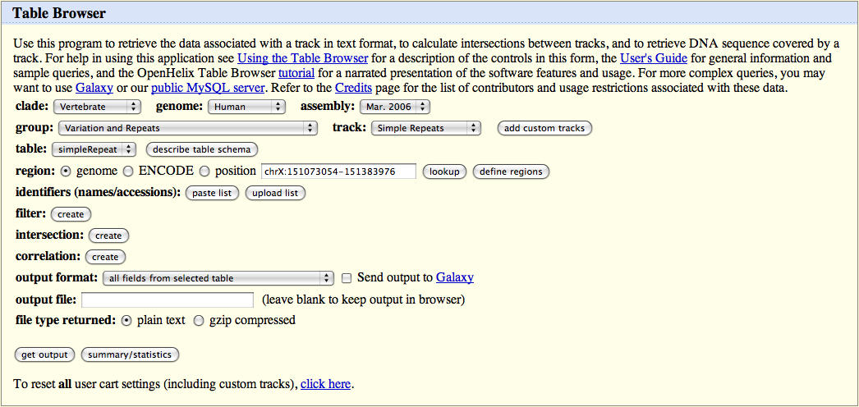
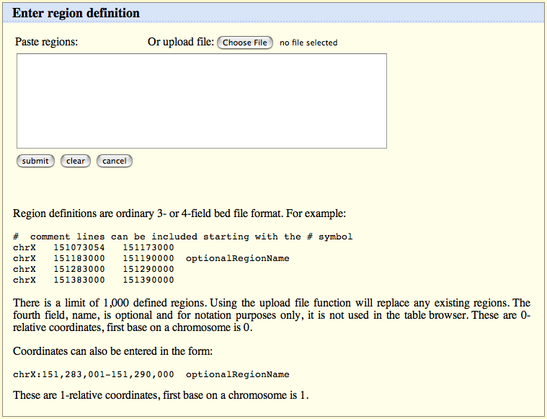
Table Browser: Choose Region to Search
Define region
Choose Region to Search
In the Human genome,
search for simple repeats on a chromosome 4 location with copy number more than 10 and download the sequence.
Notes:
The next choice is what position you want to obtain data from, you can get data from the entire genome, an ENCODE region or a specific chromosomal location. ENCODE is a project by the National Human Genome Research Institute (NHGRI) that is identifying and characterizing all functional elements in human genome sequences.
If you know a gene name, but not the chromosomal location, this “look up” button will find the location for you.
We are going to put in chromosome 4, 3 to 4 million base pairs, “chr4, colon, and 3 million dash 4 million.”
If you want to choose several regions with the genome, you can type them in or upload them with this button: “define regions.”

Slide 7
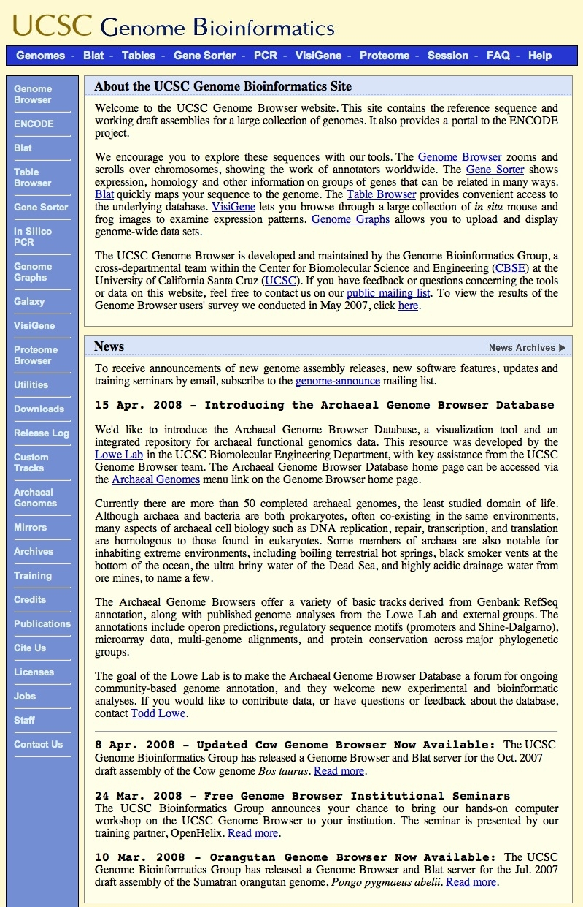
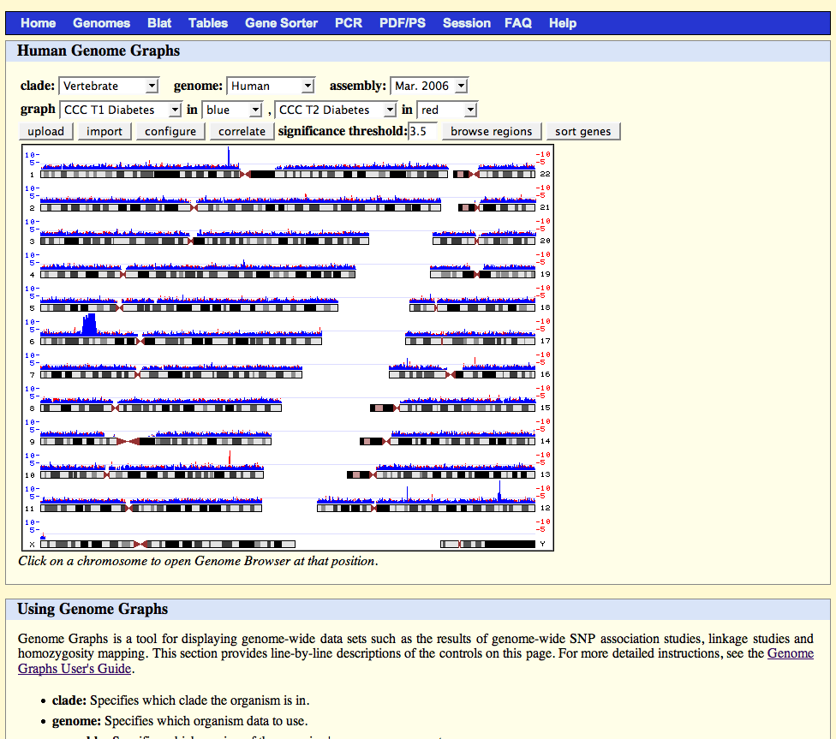
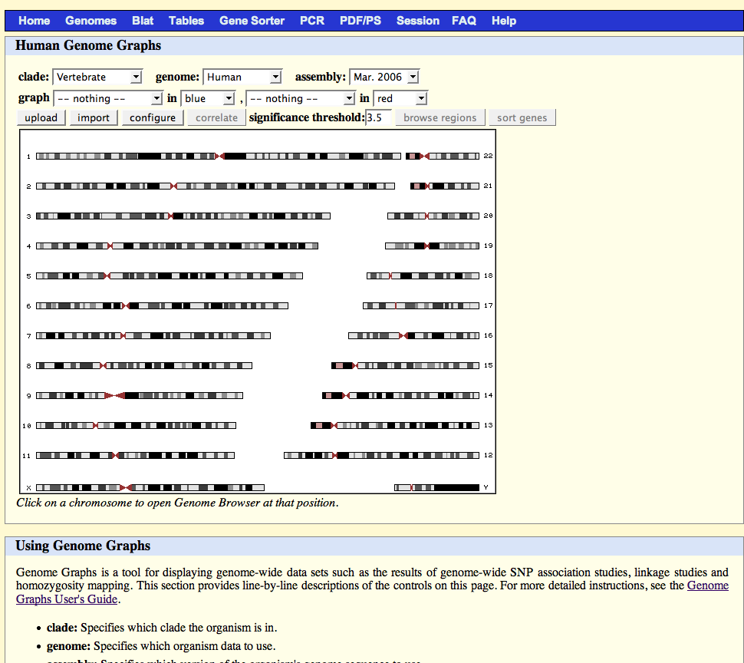
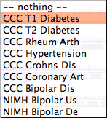
Custom Tracks: Genome Graphs
Genome Graphs
Notes:
A new way to view the data was added to the Genome Browser. This is the Genome Graphs tool. This tool allows you to view genome-wide data such as SNP association studies, linkage studies and homozygosity mapping by uploading your own custom, special tracks or viewing some data already available.
You can access this tool here, on the left navigation bar.
Here you will choose the genome and assembly you wish to view. The next menus allow you to choose previously loaded data from other studies. We’ll load two here, the CCC T1 Diabetes and the CCC T2 Diabetes studies. As you see, they are loaded here.
You could also load your own data, the users guide link below will take you to instructions on how to format this data.
You can import data from other tables in the UCSC database, configure how the data looks and correlate the data sets or change the significance threshold to view only data that is above that threshold.

Slide 8
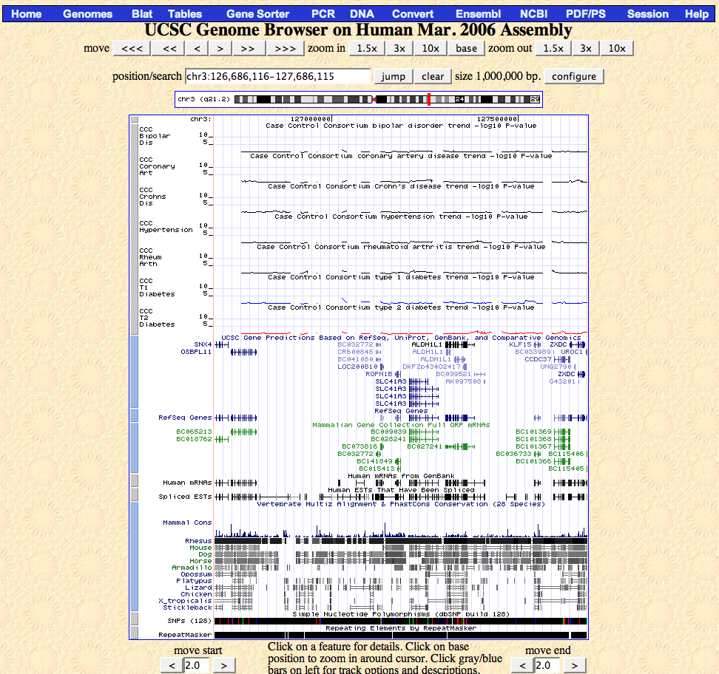
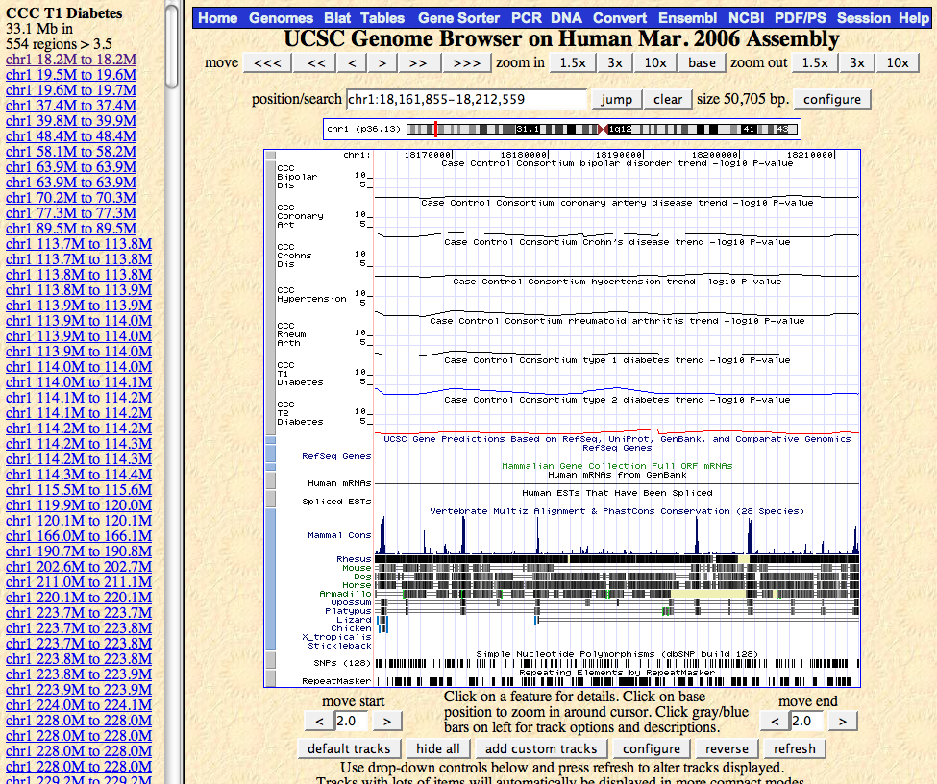
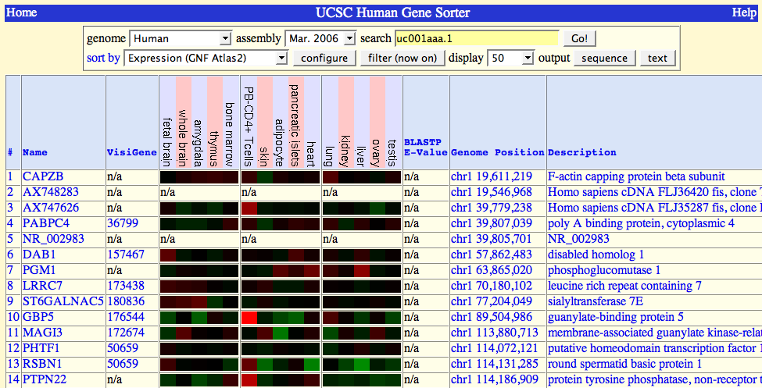
Custom Tracks: Genome Graphs
Browser
Notes:
Clicking anywhere on the graph will take you to the Genome Browser for that region where you will have the annotation track of that data shown.
You can also browse regions, allowing you to click links to different regions in the left frame and have them appear in the right frame in the Genome Browser.
And you can sort the genes that meet the threshold level in the gene sorter for further study.
This was a very quick introduction to the tool, but the Genome Graphs tool is a great way to view custom data of genome-wide studies. Take a closer look.

